Slide 1

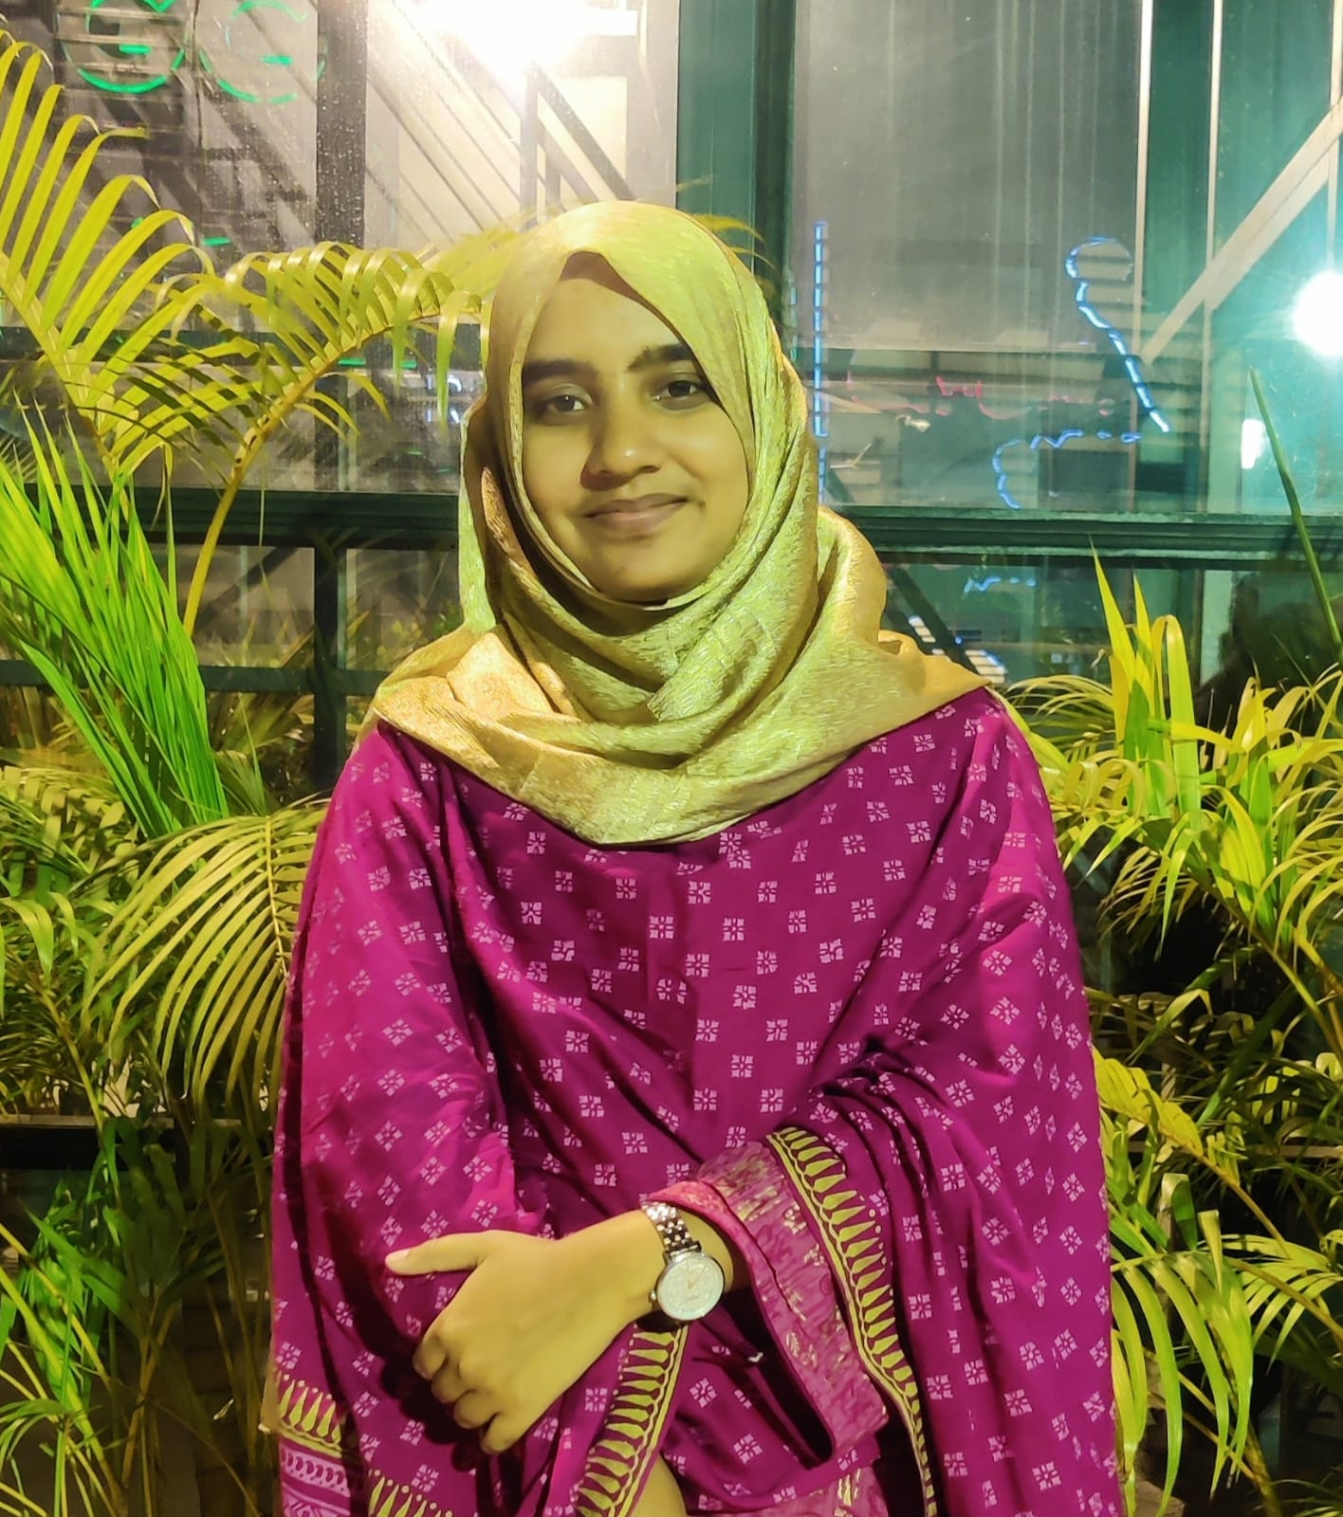
My Journey in the OLS-NASA Nebula Program
Introduction:
Name: Mst Sohana Khatun
BSc: Geography and Environment
MSc: Currently studying Master’s in Physical Geography
Institution: University of Dhaka
Nationality: Bangladeshi.

Slide 2
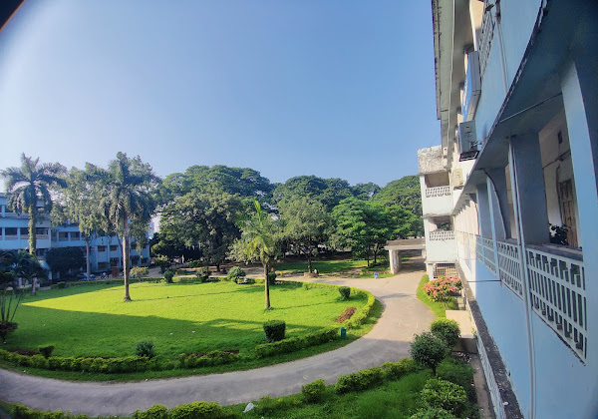
This is My Peaceful Campus (Annex Building, DU)

Slide 3
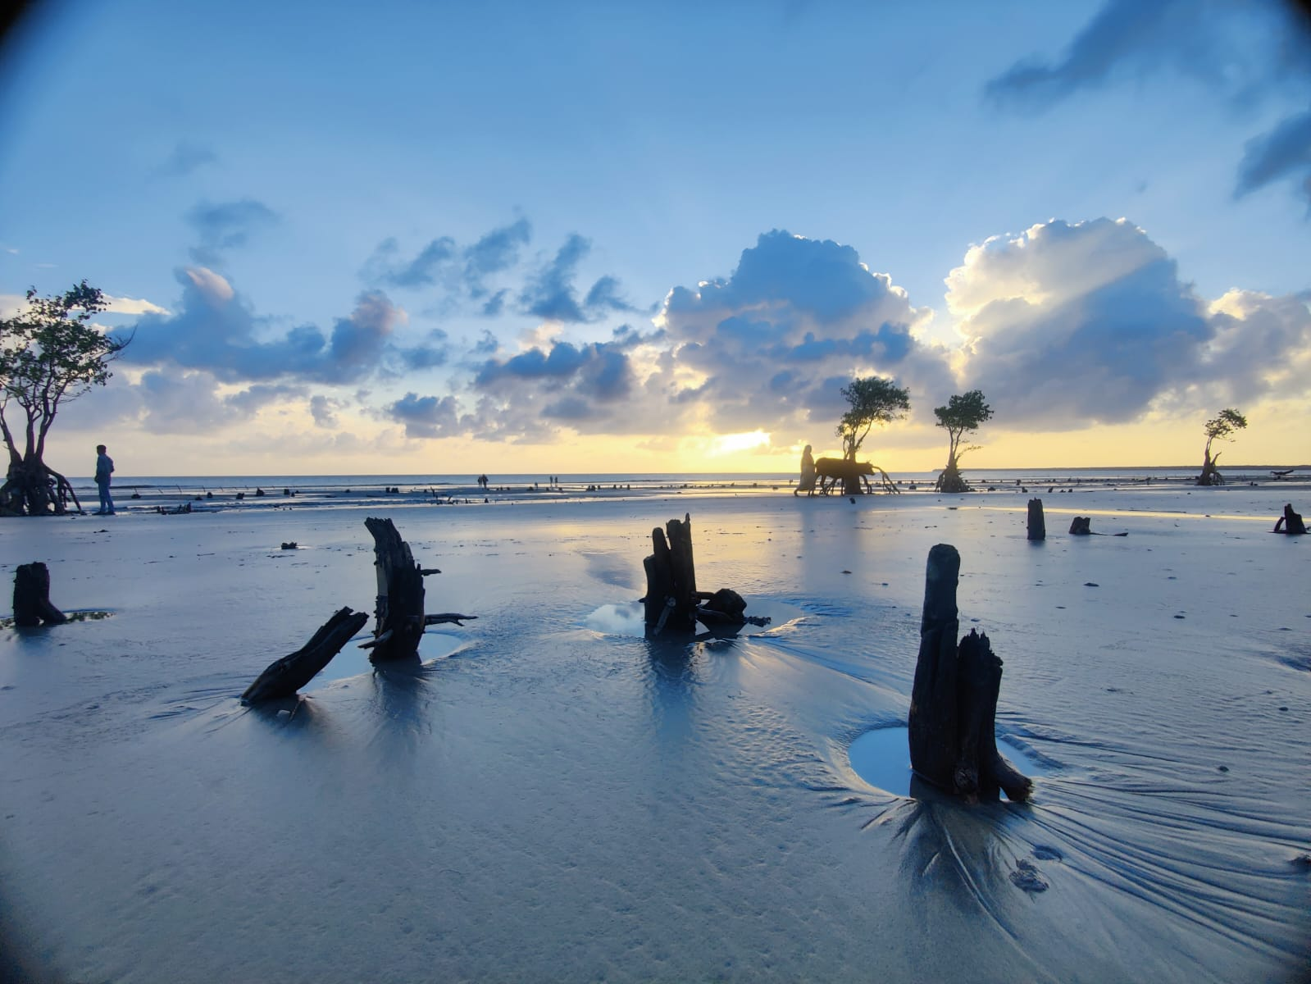
My Focus
Research focus:
Environmental sustainability
Wetland Conservation
Biodiversity Loss and Adaptation
Climate Change
Technical Expert:
GIS and Remote Sensing
Passion: Researcher

Slide 4

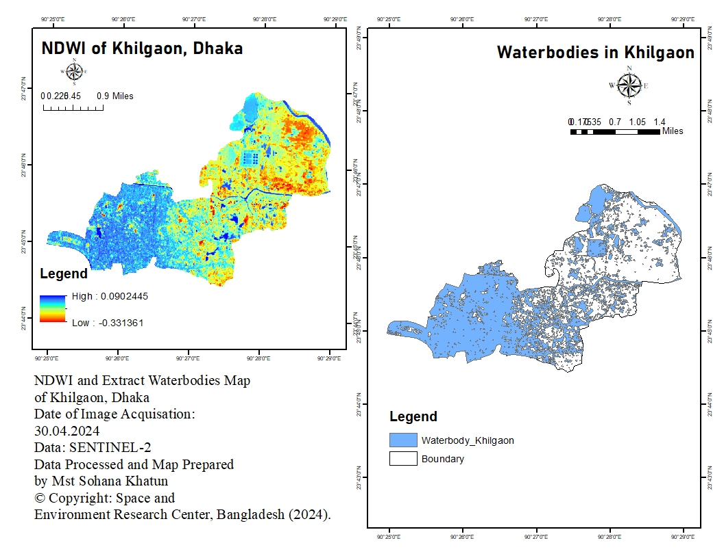
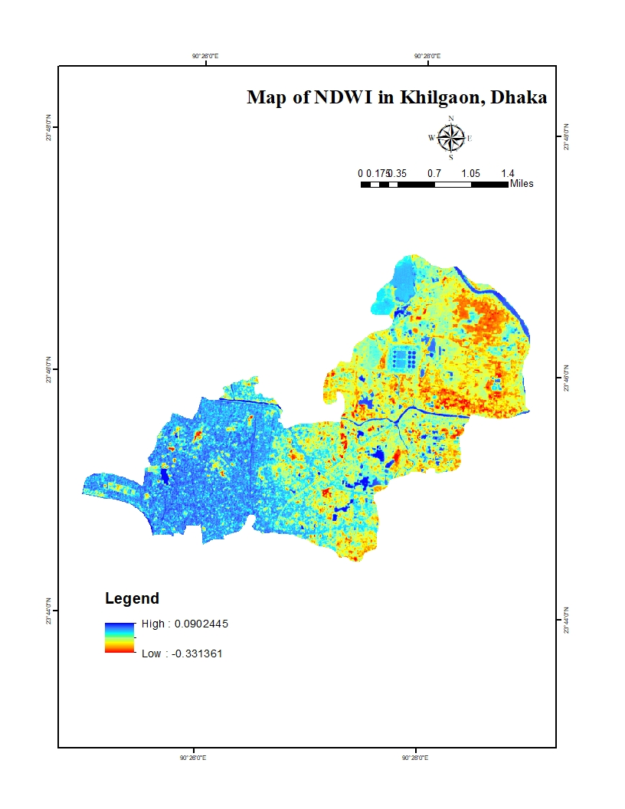
My Ongoing Project

Slide 5
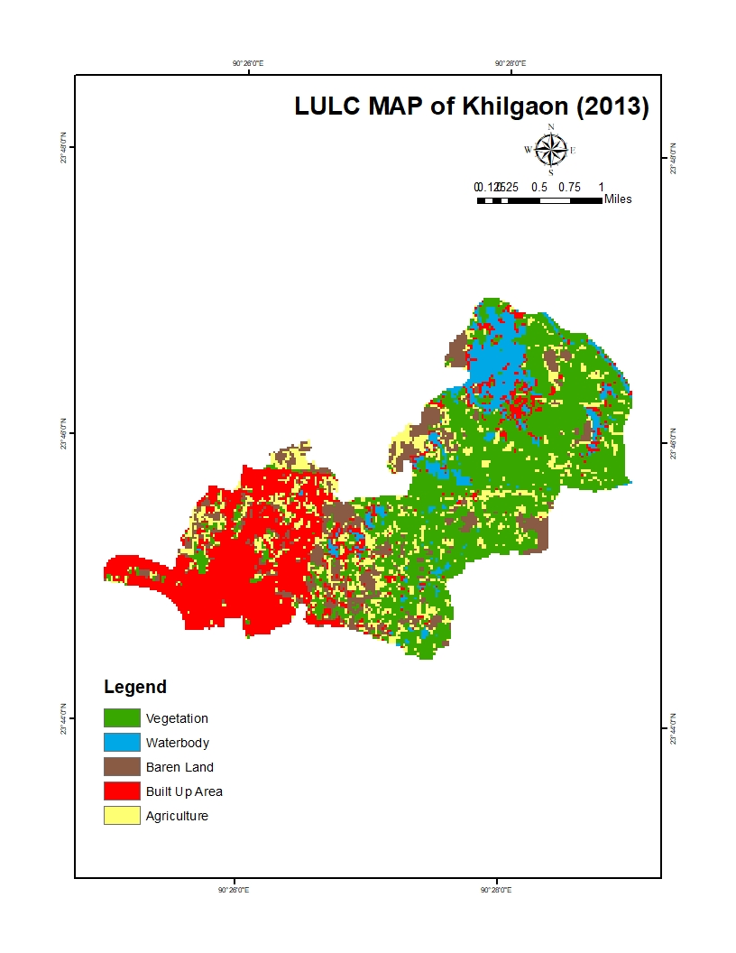
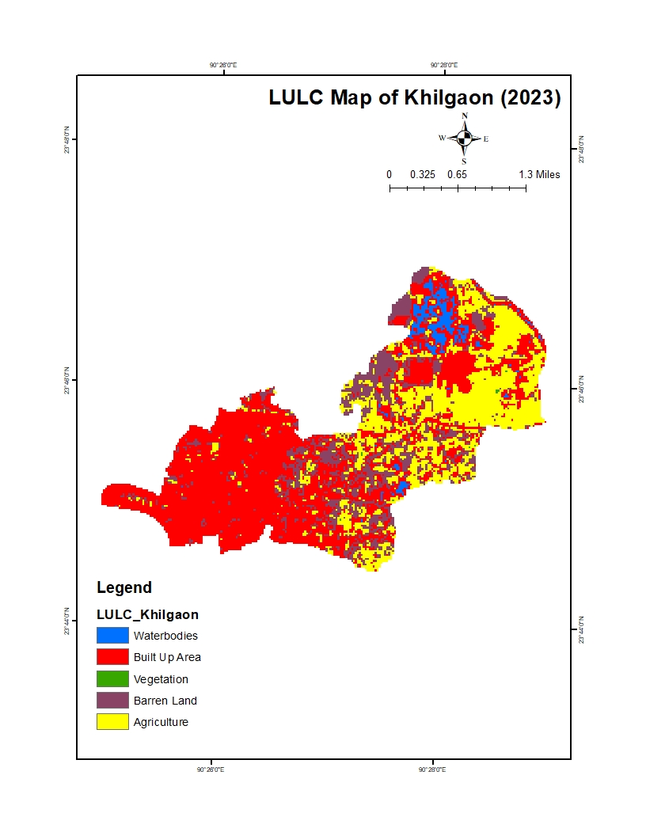
My Ongoing Project

Slide 6

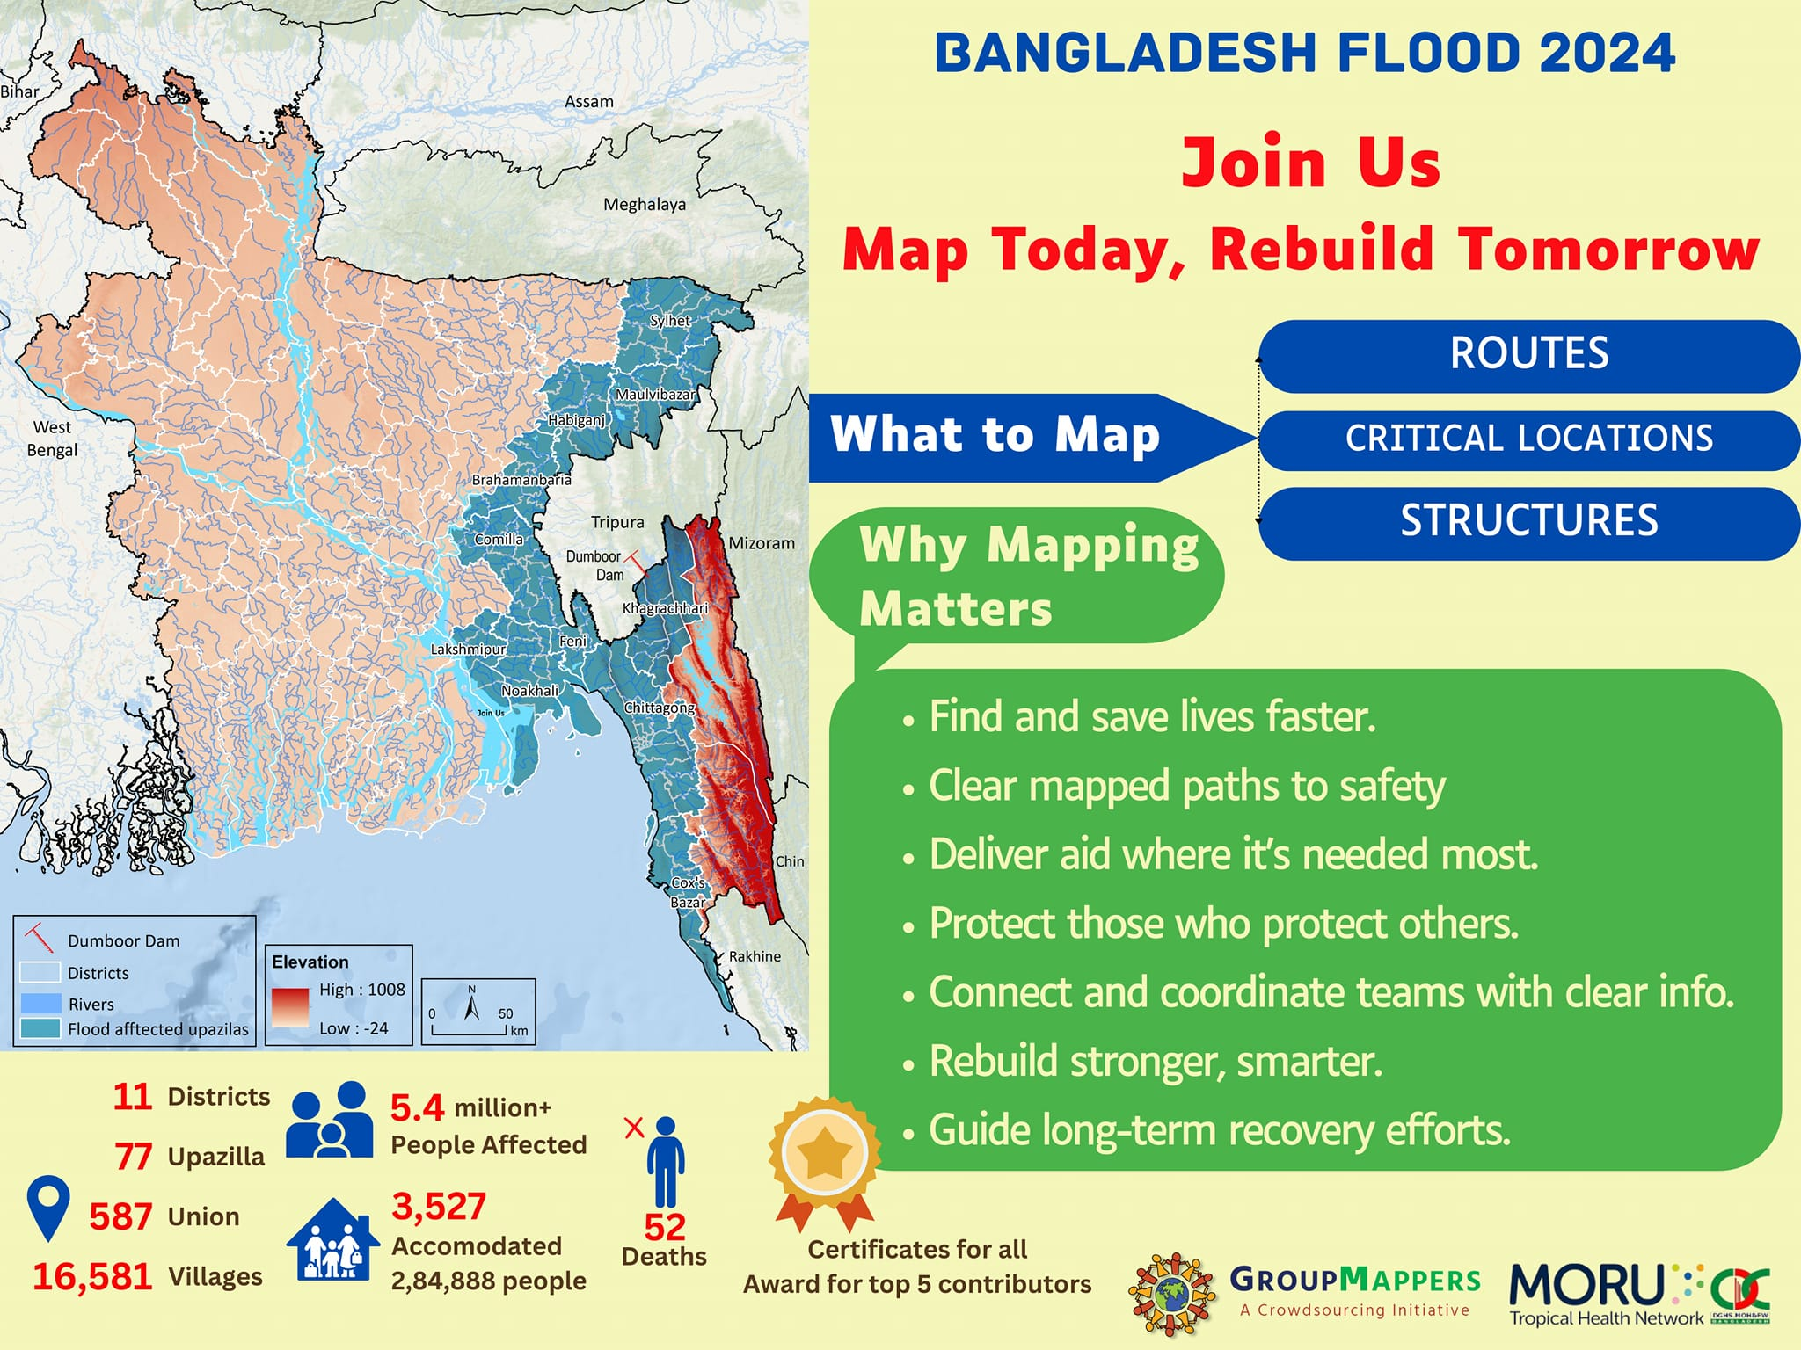
My Ongoing Project

Slide 7
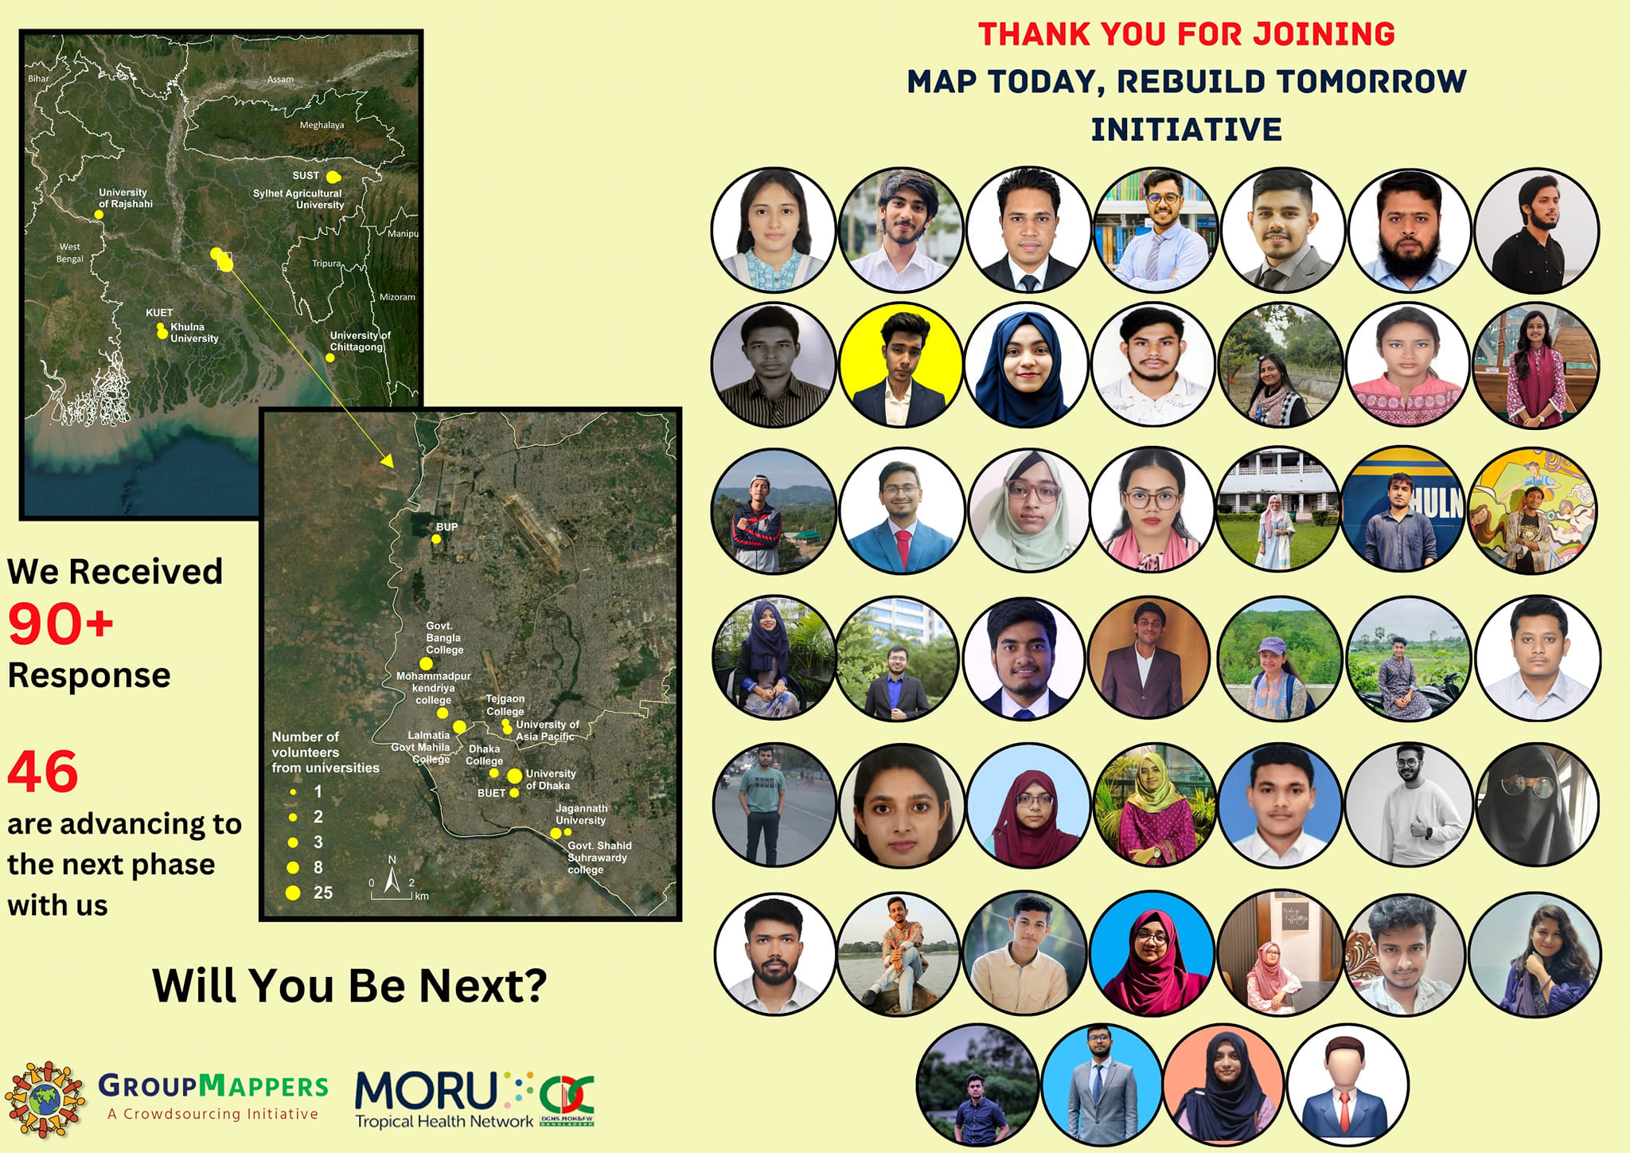
My Ongoing Project

Slide 8
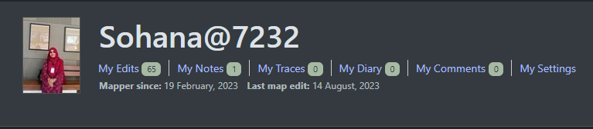
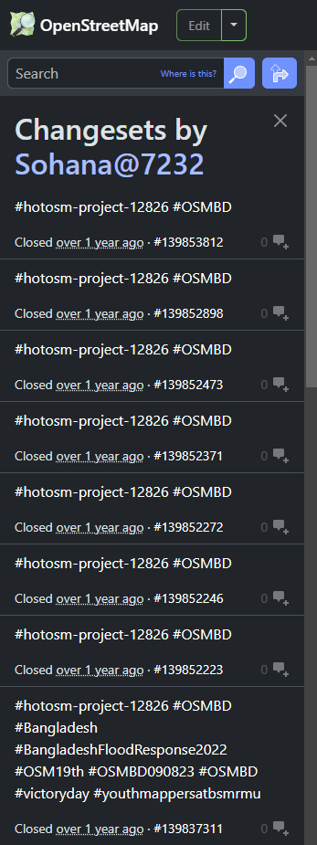
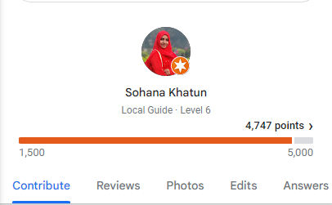
Contributions
Google Maps

Slide 9
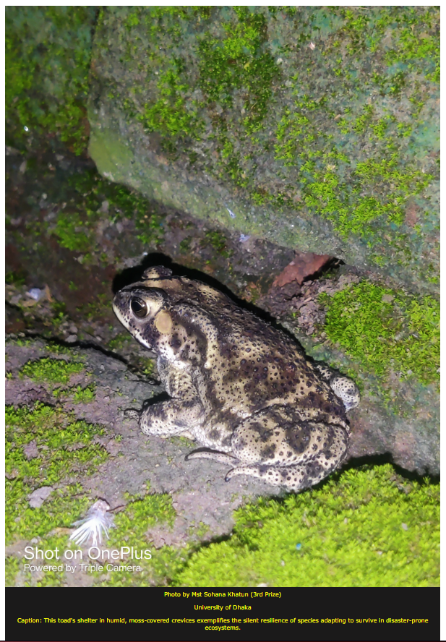
Recent Achievement
Photography Contest Winner:
The silent resilience of species adapting to survive in disaster-prone ecosystems.

Slide 10


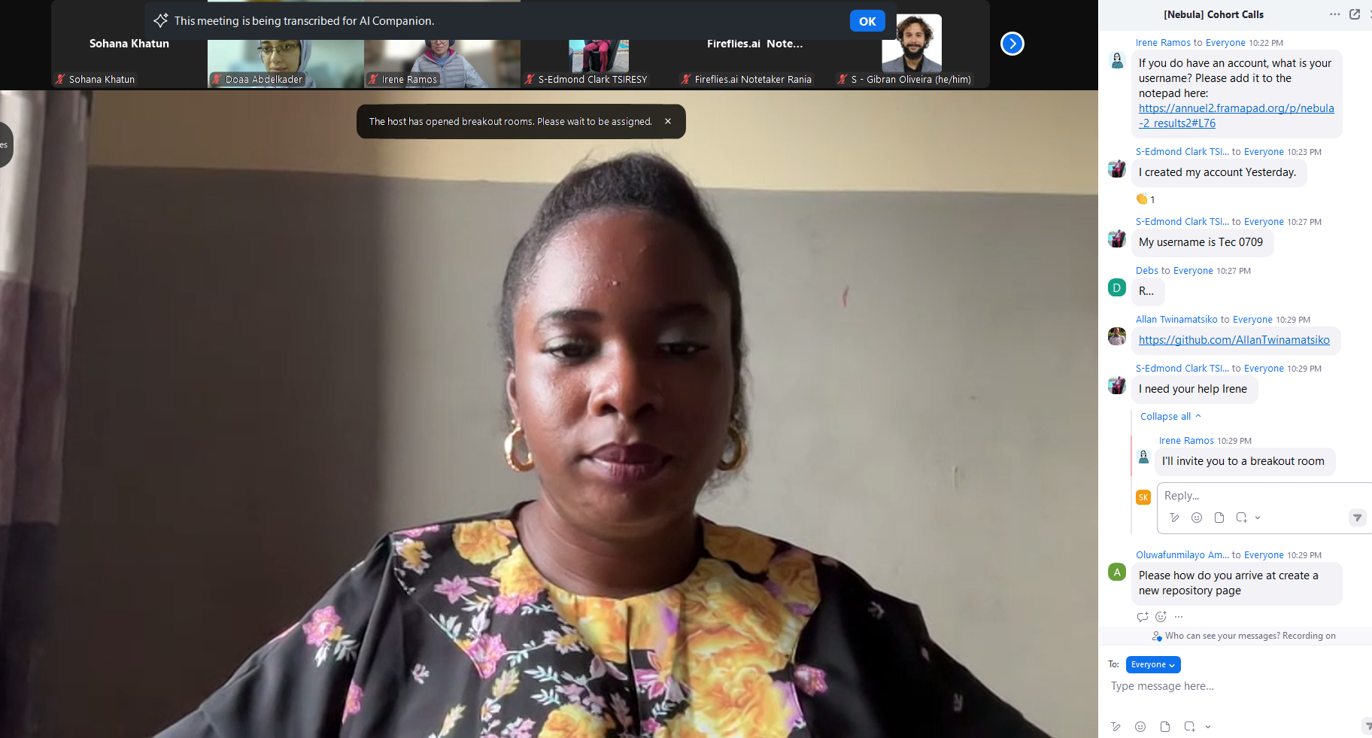
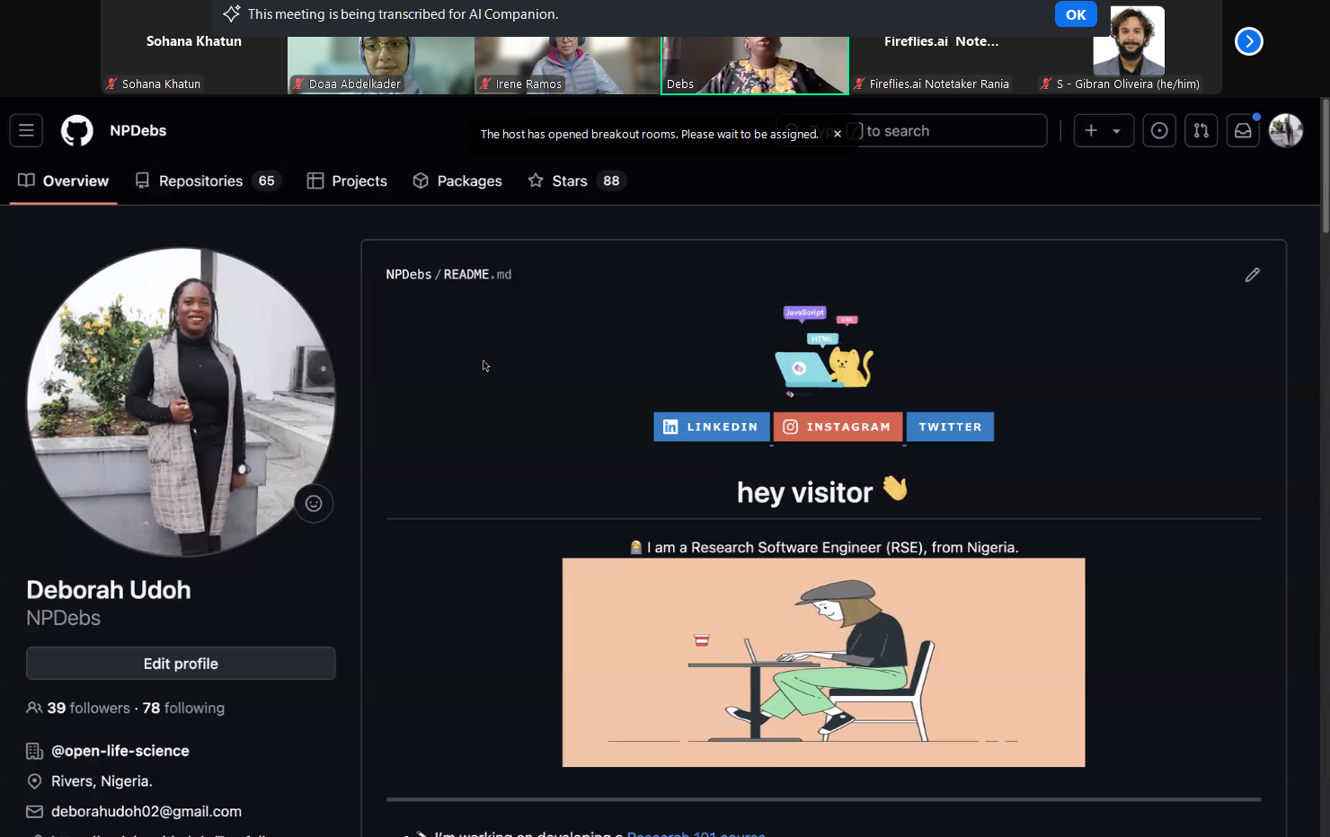

Key Learnings from Open Science
Learning 1: Open Science Principles
Learning 2: Practical Tools and Skills
Personal Growth
During the GitHub Session

Slide 11

Next Steps
Short-Term Goals:
Create a GitHub repository for my current research to share findings with peers and collaborators.
Long-Term Vision:
Adopt open-access publishing and encourage data-sharing practices among my research community.
Outreach:
Organize workshops to introduce Open Science concepts to other students in Bangladesh.

Slide 12

Acknowledgments and Graduation
Gratitude:
Thank you to the OLS team, mentors, and my cohort for their support and guidance.
Excitement:
Graduating from this program is a significant milestone
Call to Action:
Let’s continue to champion Open Science for a better, collaborative future.

Slide 13
Thank You for your Patience

